Slide 1
End-to-End Encryption Chat Application overview
Team FSociety
478 Intro to Computer Security

Slide 2
Application Properties
Java on Akka - Language and Platform
Amazon Web Server (AWS) - The server for domain
JSON (JWT) - Encoder
MySQL - Database
SSL (TLS 1.2) - Transport Layer Security

Slide 3

Assets/Stakeholders
Assets
Messages
Privacy of User
Stakeholders
User
Service Provider

Slide 4
Adversarial Model
We need to take into consideration all type of adversaries. Including passive, active, insider, and outsider.
Our assets include protecting the messages so we would need to focus on different attacks that can come from:
Server administrator
Transport Channels
In all threat situations knowing the knowledge of your adversary is very important. Knowing what the adversary knows can be the best defense in finding what spots the adversary wants to attack. You will be one step ahead of the adversary

Slide 5
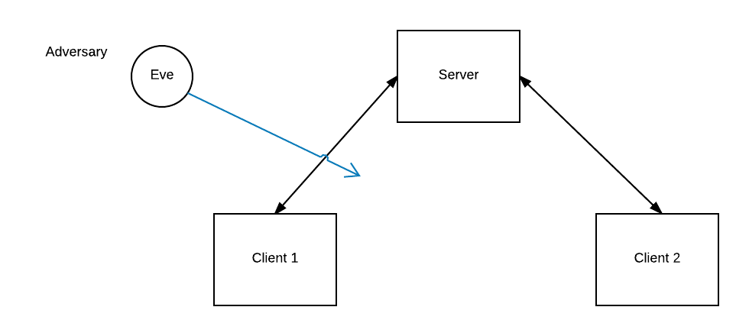
Possible Vulnerabilities
A high priority threat is a server with an admin that can read the message. This is considered an insider attack. If the server administrator can read the messages that the users send, then their privacy will be broken.
The highest priority threat to take into consideration is a man in the middle attack, as shown in Figure 1.1. In this situation the connection between the server and client is intercepted and the adversary, Eve, can see the conversation between the user and the recipient and change the messages sent between them if wanted.

Slide 6
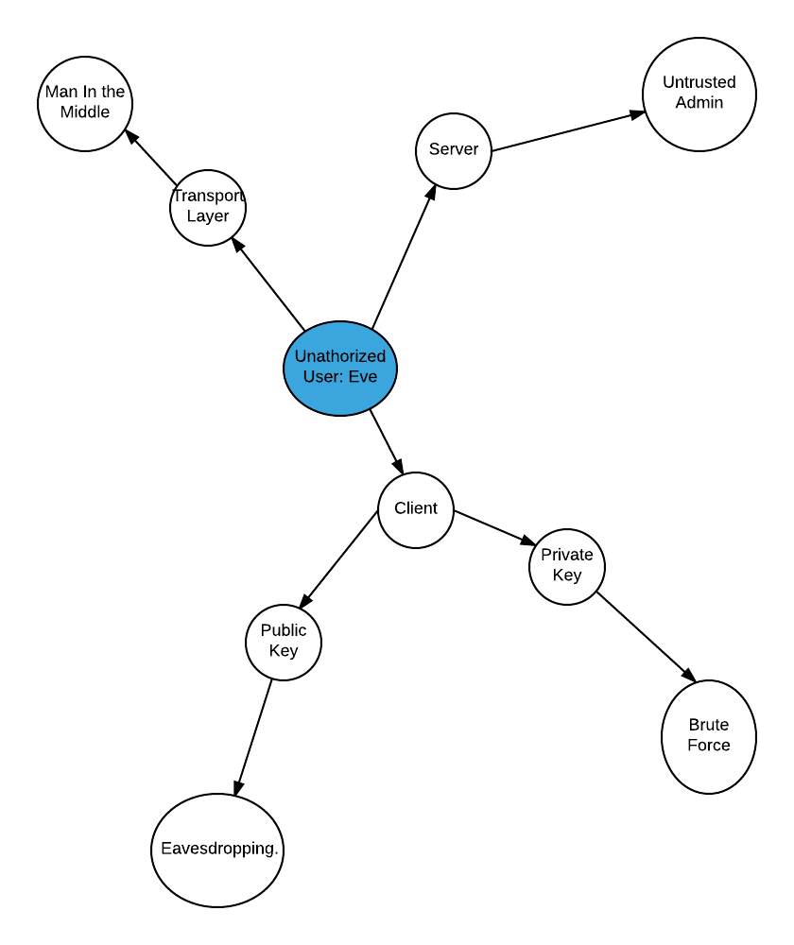
Attack tree

Slide 7
Related Work
WhatsApp
WhatsApp uses end-to-end encryption to make sure that it’s only the user and the person that they are communicating with the only people in that conversation.
WhatsApp end-to-end encryption secures messages with a lock and only the user and the receiver of the message have a special key that will unlock the message and thus be able to read them.
Every message that is sent between user and receiver in WhatsApp has its own lock and key.
WhatsApp has two terms for the types of keys they use: Session Key Types & Public Key Types
The basis of WhatsApp end-to-end encryption is the Signal Protocol
This protocol prevents WhatsApp and other parties from accessing the plaintext of either the messages or call that the user makes.

Slide 8
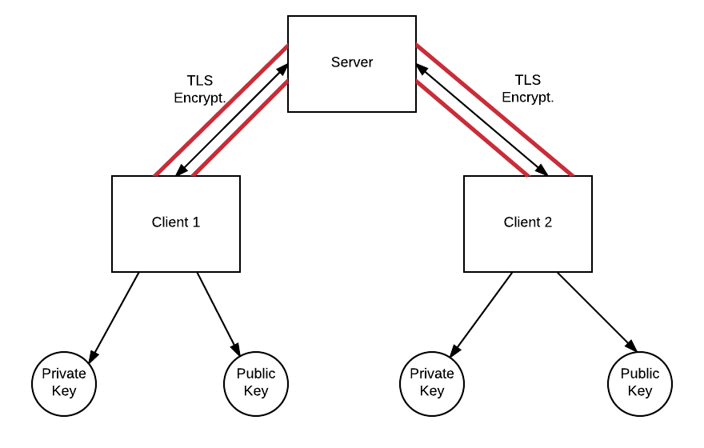
Solution Description (TLS)
Clients will both have a private key and public key.
The public key, is shared to anyone upon request for those who wishes to communicate with another client.
The connection between two clients is encrypted with TLS 1.2 (http) to keep any adversaries away, as shown in figure 1.3 where the tube surrounding the connection indicates the TLS encryption.

Slide 9
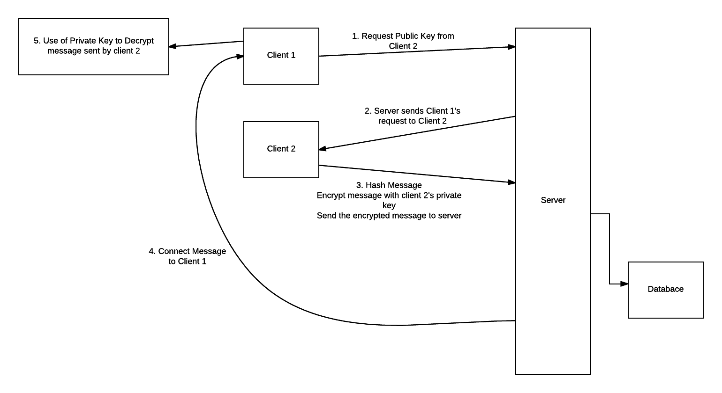
Solution description (PGP)
The communication between users is done using PGP, Pretty Good Privacy.
PGP uses the key system.
This implies that each user has a public key, generated by RSA, and a private key.
A private key is only known by the user whom the key belongs to because it is what is used to decrypt messages.
A public key is known as the encryption key, this key will encrypt the messages the user is sending. Figure 1.4 depicts how messages between users is being sent using PGP.

Slide 10
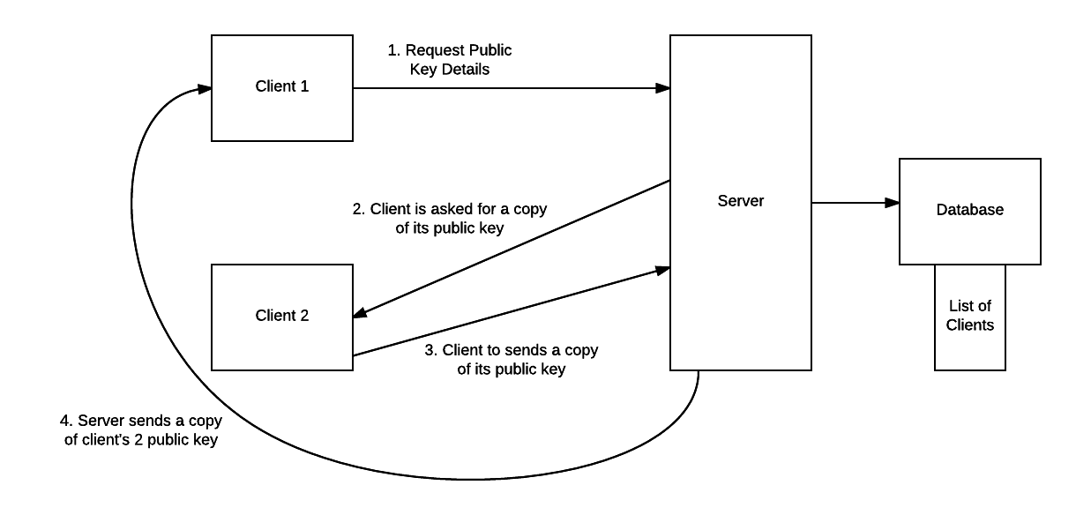
Solution Description
There is a question of how to find another user’s public key.
This question is answered by encryption and database.
An example would be making a copy of the key, hashing the key value, and encrypting the key.
The encryption will have the copy of the public key multiplied by a prime factor (random generated).
Then, for the database, the user will see a list of other clients to send their copied, encrypted key.
The recipient will then be able to decrypt the key with their private key to do the vice versa.
Figure 1.5 gives a general example of a user requesting another user’s public key.

Slide 11
Analysis
T.L.S will allow the client and server to have secure communication because the channel that links them together will be private and no adversaries will be able to be a threat.
PGP will allow for a secure exchange of message content with integrity because PGP will encrypt messages that will not be tampered or violated by third parties. With the help of RSA, the encryption will be concatenated by an alphanumeric key with the size of 2048 bits, making it hard to brute force or any other method of cryptography.
We took into consideration a user request for another user’s public key. We understand that user activity is meant to be discrete. Using a prime number to exchange public keys will be used since it’s not factorable by any other set of keys except by 1 and itself. With the help of the database, the exchange of public keys will be possible and kept protected from eavesdroppers.

